Slide 1

Time series and trend analysis
Data Science & analytics (it3080)

Slide 2
Overview
Introduction to time series
Components of time series
Forecasting with time series
Decomposition method for forecasting

Slide 3
Learning outcomes
At the end of this session, students should be able to
  Identify applications of time series
  Explain different components of a time series
  Explain how decomposition method could be used for forecasting

Slide 4
introduction
Many prediction problems are associated with a time component.
Time series refers to a set of data collected at specific intervals over a period of time.
Time series analysis examines a series of data over time.
In studying the series, patterns become evident and these patterns are used to assist with future decision making.

Slide 5
Applications of time series
Economic Forecasting
Sales Forecasting
Budgetary Analysis
Stock Market Analysis
Census Analysis &
Etc..

Slide 6
Time series analysis
Time series analysis is used to understand a time series dataset.
Time series analysis involves developing models that best capture or describe an observed time series in order to understand the underlying causes.
Time series analysis is used in two ways
  Obtain an understanding of the underlying forces and structure that produced the observed data.
  Fit a model and proceed to the next level, which is time series forecasting, monitoring or even feedback and feedforward control.

Slide 7
Time series forecasting
Time series forecasting involves making predictions about the future.
Time series forecasting involves taking models fit on historical data and using them to predict future observations.
The skill of a time series forecasting model is determined by its performance at predicting the future.
Different factors may affect the values of an observation in a time series, and these factors are called components of a time series.

Slide 8
Components of time series
The four main components of time series are;
  Trend
  Seasonal Variations
  Cyclic Variations
  Random or Irregular movements

Slide 9
trend
Trend refers to the general tendency of the time series data to increase or decrease during a long period of time.
Trend may increase or decrease (or remain stable) at different moments in the given period of time that you are observing.
However, overall there is a overarching trend
Ex: Population counts, agricultural production, items manufactured, number of births and deaths.

Slide 10
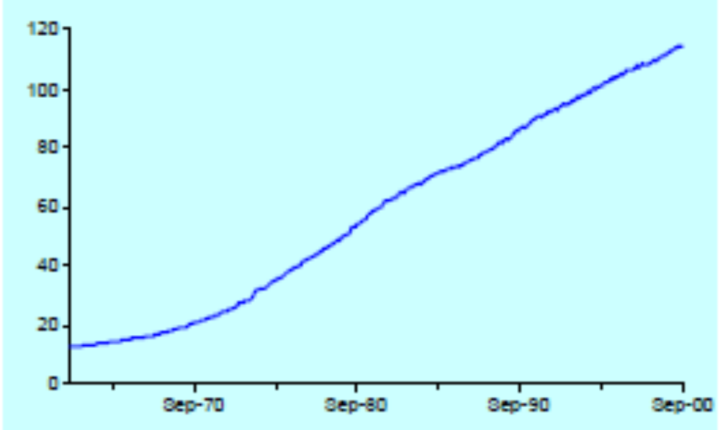
Trend (contd.)

Slide 11
Seasonal variations
Seasonal variations are the rhythmic forces which operate in a regular and periodic manner over a span of less than a year.
They have the same or almost the same pattern during a period of 12 months.
This variation will be present in a time series if the data are recorded hourly, daily, weekly, quarterly, or monthly.
These variations come into play either because of the natural forces or man-made conventions.

Slide 12
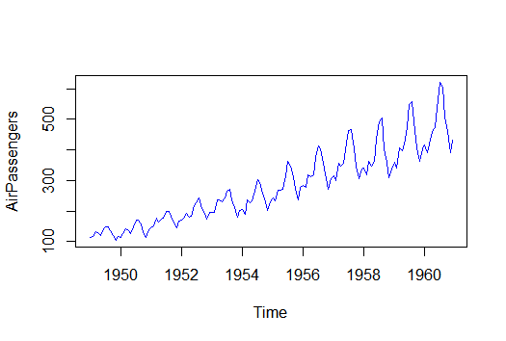
Seasonal variations (contd.)

Slide 13
Cyclic variations
Cyclic variations are oscillations in a time series which operate over a span of more than one year.
One complete period is a cycle, but a cycle will not have a specific fixed length of time.
This cyclic movement is sometimes called the ‘Business Cycle’.
It is a four-phase cycle comprising of the phases of prosperity, recession, depression, and recovery.
The upswings and the downswings in business depend upon the joint nature of the economic forces and the interaction between them.

Slide 14
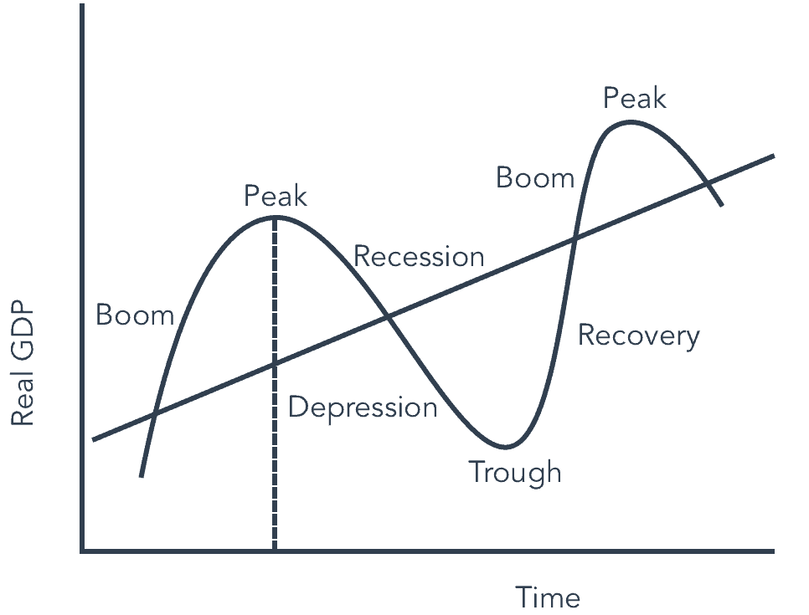
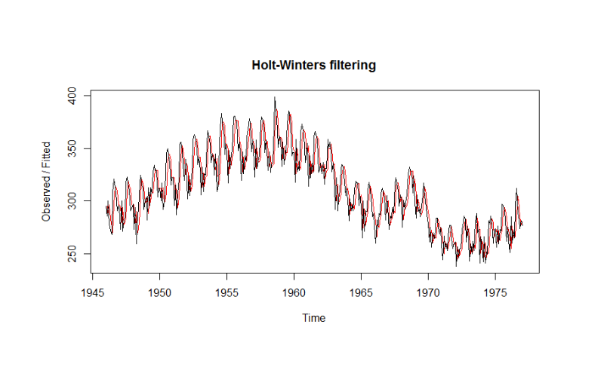
Cyclic variations (contd.)

Slide 15
Random or irregular movements
The random variations of the data comprise the deviations of the observed time series from the underlying pattern.
Random, or irregular, fluctuations are the last factor to cause variations in our time series data are.
These fluctuations are unforeseen, uncontrollable, unpredictable, and are erratic, such as earthquakes, wars, flood, famines, and any other natural disasters.

Slide 16
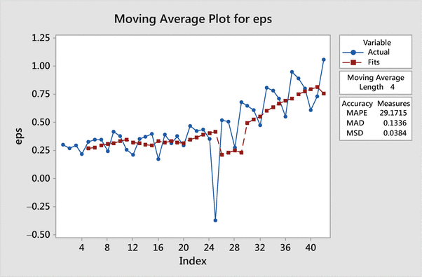
Random or irregular movements (Contd.)

Slide 17
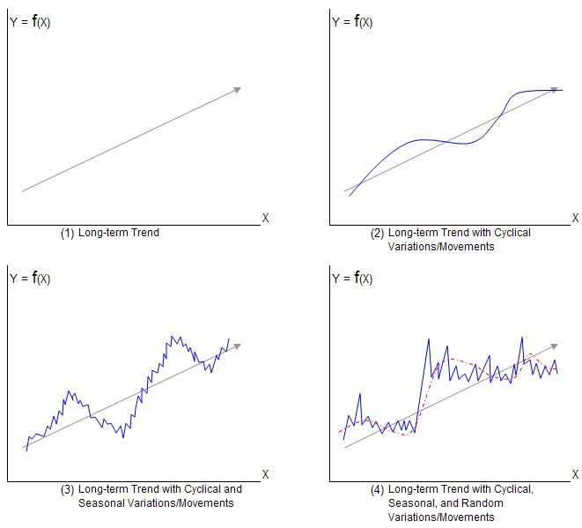
Time series in real life
The four components of a time series (T: trend, S: seasonal, C: cyclical, R: random) can be combined in different ways.

Slide 18
Forecasting with time series
Decomposition methods /Classical Models
  Additive models
  Multiplicative models
Probabilistic Model
  AR model
  MA model
  Mix models (Ex: ARMA, ARIMA, SARIMA & etc)

Slide 19
Decomposition methods
Describing a time series could be done by creating separate models for the four elements T(Trend), S(Seasonal), C(Cyclical), I(Irregular) and then by combining them in to following methods
  Additive Model
  Y_{t}= T_{t}+S_{t}+ C_{t}+I_{t}
  Multiplicative Model:
  Y_{t}= T_{t} x S_{t} x C_{t} x I_{t}

Slide 20
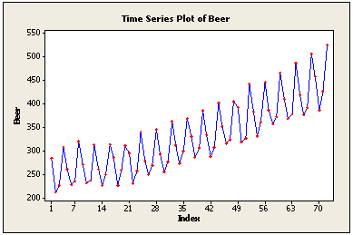
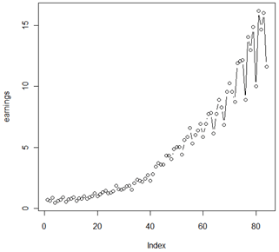
Decomposition methods (contd.)
The additive model is useful when the seasonal variation is relatively constant over time.
The multiplicative model is useful when the seasonal variation increases over time.

Slide 21
Forecasting using decomposition methods
Estimate the trend
“De-trend” the series.
  For an additive decomposition, this is done by subtracting the trend estimates from the series.
  For a multiplicative decomposition, this is done by dividing the series by the trend values.
Estimate the seasonal trend using de-trend series
De-seasonalize the data
Determine the random (irregular) component.

Slide 22
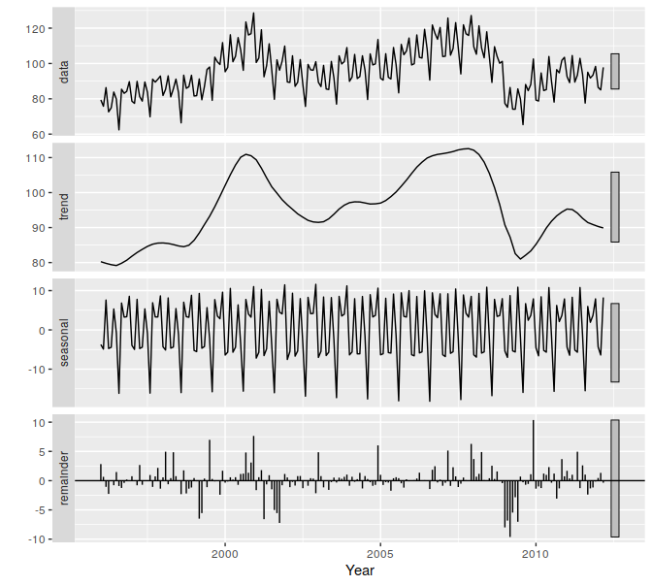
An example – additive decompositioN

Slide 23
estimating trend – Moving average
One approach to estimate the trend is using moving averages.
Moving average is a technique that replaces a data value with the average of that data value and neighboring data values.
A moving average for a time period is the average of N consecutive data values, including the data value for that time period.

Slide 24
estimating trend – Moving average (Contd.)
The technique for finding a moving average for a particular observation is to find the average of the m observations before the observation, the observation itself and the m observations after the observation
Thus a total of (2m + 1) observations must be averaged each time a moving average is calculated.
A centered moving average is a moving average such that the time period is at the center of the N time periods used to determine which values to average.
The trend values were determined as “centered“ moving average

Slide 25
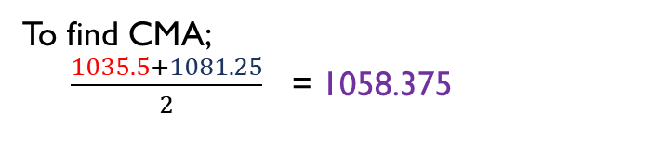
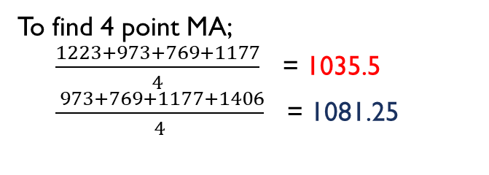
Moving average -example
t | X_{t} | 4 point MA | CMA= Y_{t}
1 | 1223
2 | 973
3 | 769 |  | 1058.375
4 | 1177 |  | 1084.25
5 | 1406 |  | 1073.75
6 | 997 |  | 1040.75
7 | 661 |  | 1003.625
8 | 1021 |  | 986.875
9 | 1265 |  | 995.5
10 | 1004 |  | 1029.125
11 | 723
12 | 1228
To find 4 point MA;
$\frac{1223+973+769+1177}{4}$ = 1035.5
$\frac{ 973+769+1177+1406}{4}$ = 1081.25
1035.5
1081.25
1087.25
To find CMA;
$\frac{1035.5+1081.25}{2}$ = 1058.375
1060.25
1021.25
986
987.75
1003.25
1055

Slide 26
De trending – multiplicative Decomposition
t | X_{t} | 4 point MA | CMA= Y_{t} | X_{t} /Y_{t (De-trend data)}
1 | 1223
2 | 973
3 | 769 |  | 1058.375 | 0.7266
4 | 1177 |  | 1084.25 | 1.0855
5 | 1406 |  | 1073.75 | 1.3094
6 | 997 |  | 1040.75 | 0.9580
7 | 661 |  | 1003.625 | 0.6586
8 | 1021 |  | 986.875 | 1.0346
9 | 1265 |  | 995.5 | 1.2707
10 | 1004 |  | 1029.125 | 0.9756
11 | 723
12 | 1228
1035.5
1081.25
1087.25
1060.25
1021.25
986
987.75
1003.25
1055

Slide 27
De-seasonalizing data
De-seasonalizing refers to a procedure involves use of a seasonal index to remove the effect of typical seasonal fluctuation from a time series data value.
A seasonal index is a factor that adjusts a trend value to compensate for typical seasonal fluctuation in that period of a seasonal cycle.
A seasonal index is a measure of how a particular season compares with the average season.

Slide 28
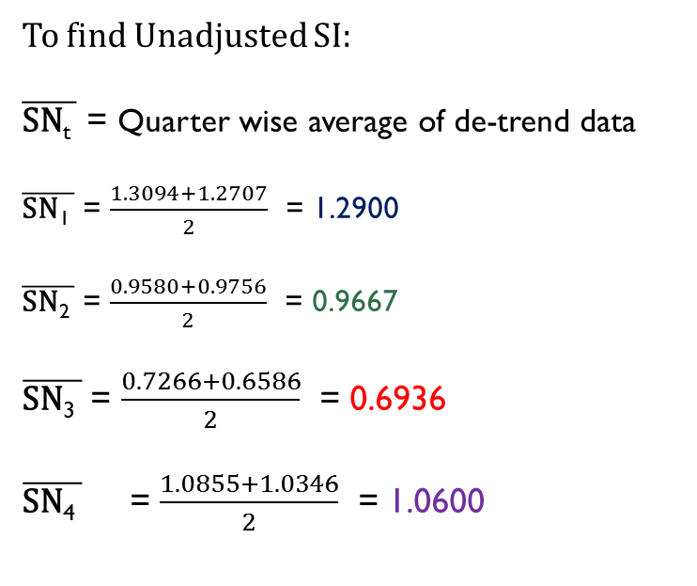
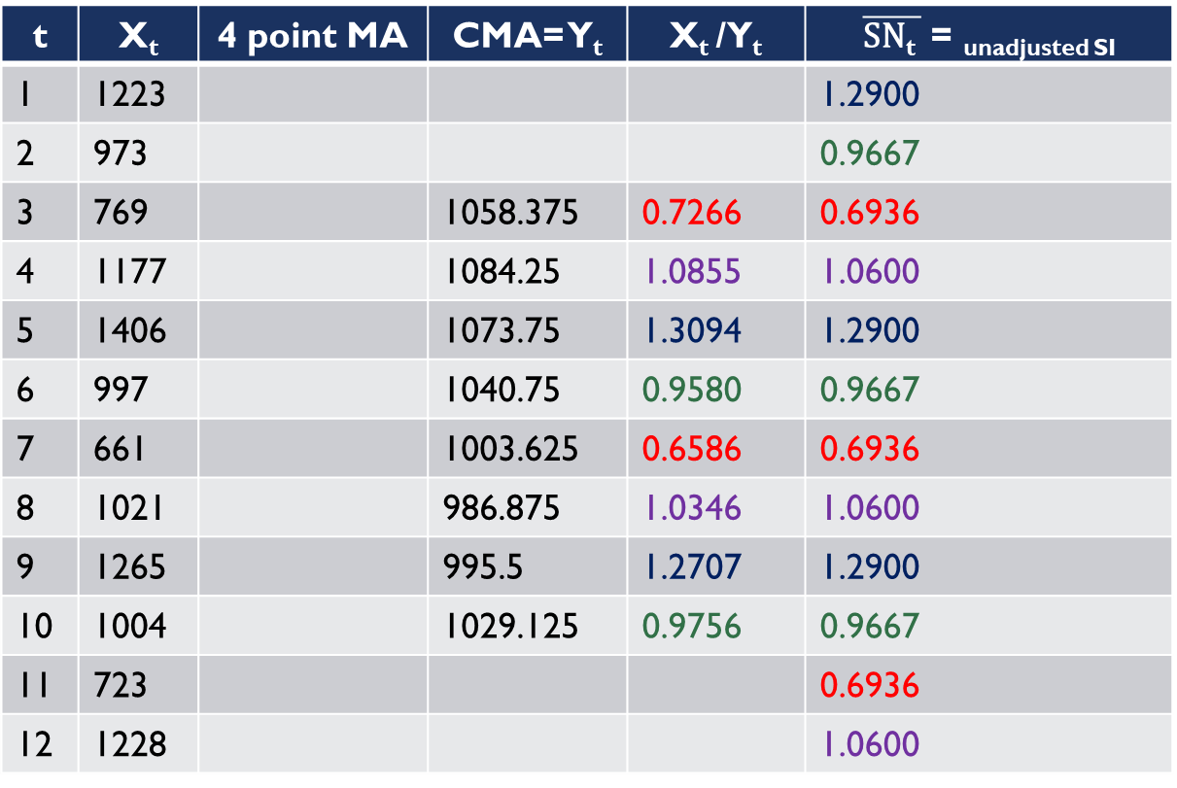
Computing the unadjusted seasonal index
t | X_{t} | 4 point MA | CMA= Y_{t} | X_{t} /Y_{t} | $\overline{\text{SN}\text{t} }$ = _{unadjusted SI}
1 | 1223 |  |  |  | 1.2900
2 | 973 |  |  |  | 0.9667
3 | 769 |  | 1058.375 | 0.7266 | 0.6936
4 | 1177 |  | 1084.25 | 1.0855 | 1.0600
5 | 1406 |  | 1073.75 | 1.3094 | 1.2900
6 | 997 |  | 1040.75 | 0.9580 | 0.9667
7 | 661 |  | 1003.625 | 0.6586 | 0.6936
8 | 1021 |  | 986.875 | 1.0346 | 1.0600
9 | 1265 |  | 995.5 | 1.2707 | 1.2900
10 | 1004 |  | 1029.125 | 0.9756 | 0.9667
11 | 723 |  |  |  | 0.6936
12 | 1228 |  |  |  | 1.0600
To find Unadjusted SI:
$\overline{\text{SN}\text{t} }$ = Quarter wise average of de-trend data
$\overline{\text{SN}\text{1} }$ = $\frac{1.3094+1.2707}{2}$ = 1.2900
$\overline{\text{SN}\text{2} }$ = $\frac{0.9580+0.9756}{2}$ = 0.9667
$\overline{\text{SN}\text{3} }$ = $\frac{0.7266+0.6586}{2}$ = 0.6936
$\overline{\text{SN}\text{4} }$ = $\frac{1.0855+1.0346}{2}$ = 1.0600
1035.5
1081.25
1087.25
1060.25
1021.25
986
987.75
1003.25
1055

Slide 29
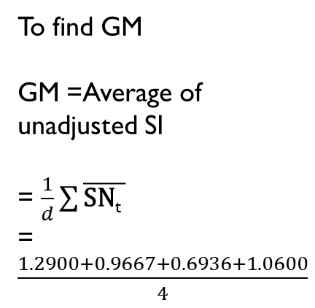
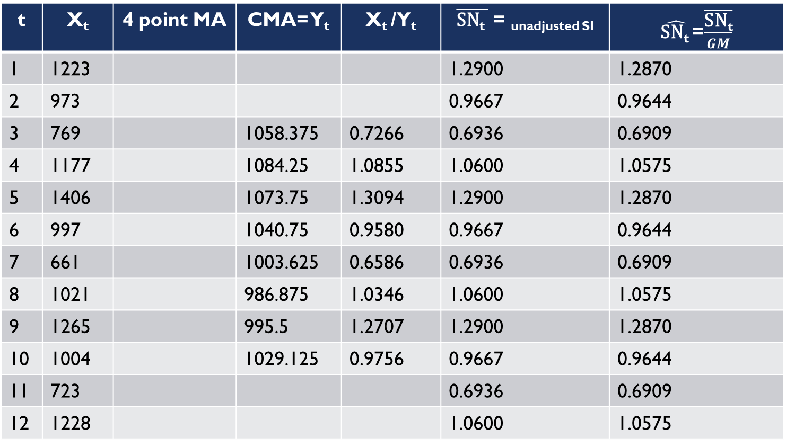
Computing the adjusted seasonal index
t | X_{t} | 4 point MA | CMA= Y_{t} | X_{t} /Y_{t} | $\overline{\text{SN}\text{t} }$ = _{unadjusted SI} | $\hat{\text{SN}\text{t} }$=$\overline{\frac{\text{SN}\text{t}}{GM}}$
1 | 1223 |  |  |  | 1.2900 | 1.2870
2 | 973 |  |  |  | 0.9667 | 0.9644
3 | 769 |  | 1058.375 | 0.7266 | 0.6936 | 0.6909
4 | 1177 |  | 1084.25 | 1.0855 | 1.0600 | 1.0575
5 | 1406 |  | 1073.75 | 1.3094 | 1.2900 | 1.2870
6 | 997 |  | 1040.75 | 0.9580 | 0.9667 | 0.9644
7 | 661 |  | 1003.625 | 0.6586 | 0.6936 | 0.6909
8 | 1021 |  | 986.875 | 1.0346 | 1.0600 | 1.0575
9 | 1265 |  | 995.5 | 1.2707 | 1.2900 | 1.2870
10 | 1004 |  | 1029.125 | 0.9756 | 0.9667 | 0.9644
11 | 723 |  |  |  | 0.6936 | 0.6909
12 | 1228 |  |  |  | 1.0600 | 1.0575
To find GM
GM =Average of unadjusted SI
= $\frac{1}{d}\sum{\overline{\text{SN}\text{t} }}$
=$\frac{1.2900+0.9667+0.6936+1.0600}{4}$
1035.5
1081.25
1087.25
1060.25
1021.25
986
987.75
1003.25
1055

Slide 30
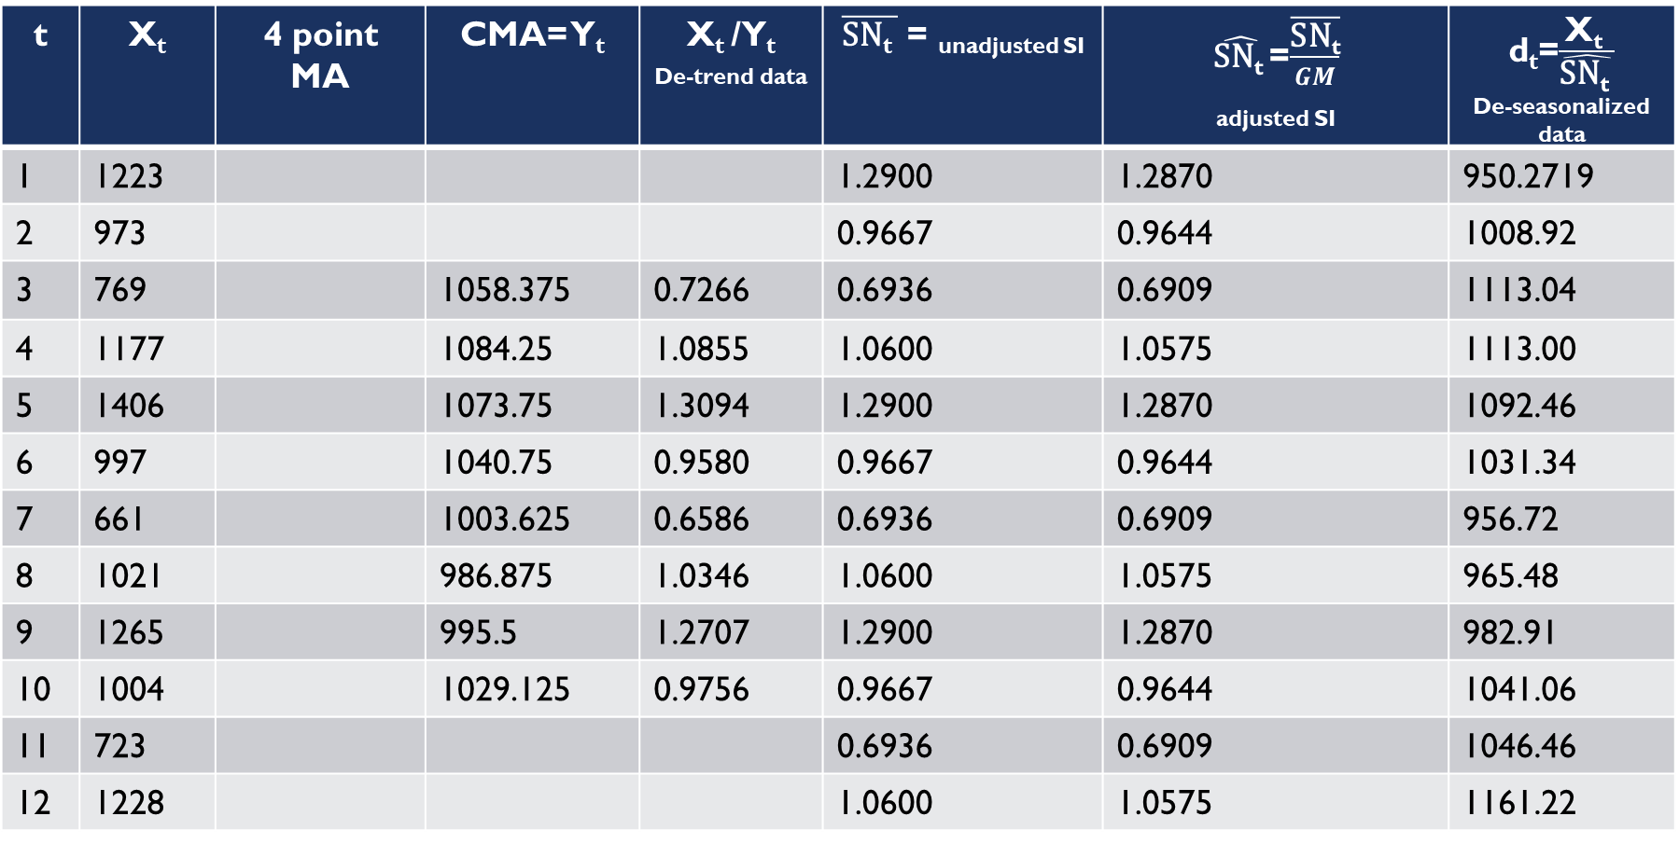
De-seasonalized data
t | X_{t} | 4 point MA | CMA= Y_{t} | X_{t} /Y_{t} _{De-trend data} | $\overline{\text{SN}\text{t} }$ = _{unadjusted SI} | $\hat{\text{SN}\text{t} }$=$\overline{\frac{\text{SN}\text{t}}{GM}}$ _{adjusted SI} | d_{t}=$\frac{\text{X}\text{t} }{\hat{\text{SN}\text{t} }}$ _{De-seasonalized data}
1 | 1223 |  |  |  | 1.2900 | 1.2870 | 950.2719
2 | 973 |  |  |  | 0.9667 | 0.9644 | 1008.92
3 | 769 |  | 1058.375 | 0.7266 | 0.6936 | 0.6909 | 1113.04
4 | 1177 |  | 1084.25 | 1.0855 | 1.0600 | 1.0575 | 1113.00
5 | 1406 |  | 1073.75 | 1.3094 | 1.2900 | 1.2870 | 1092.46
6 | 997 |  | 1040.75 | 0.9580 | 0.9667 | 0.9644 | 1031.34
7 | 661 |  | 1003.625 | 0.6586 | 0.6936 | 0.6909 | 956.72
8 | 1021 |  | 986.875 | 1.0346 | 1.0600 | 1.0575 | 965.48
9 | 1265 |  | 995.5 | 1.2707 | 1.2900 | 1.2870 | 982.91
10 | 1004 |  | 1029.125 | 0.9756 | 0.9667 | 0.9644 | 1041.06
11 | 723 |  |  |  | 0.6936 | 0.6909 | 1046.46
12 | 1228 |  |  |  | 1.0600 | 1.0575 | 1161.22
1035.5
1081.25
1087.25
1060.25
1021.25
986
987.75
1003.25
1055

Slide 31

Thank You

